Slide 1
Scavenger Hunt!
How many of these things can you find at home?
Notes:
Note. Please edit to match age, developmental level etc. This can be used for engagement, session icebreaker, Joining and Enactments. Notes on how to expand FCT application are added to specific slides.
Special thanks to Jennifer Kastner of Lutheran Social Services for sending this resource.

Slide 2
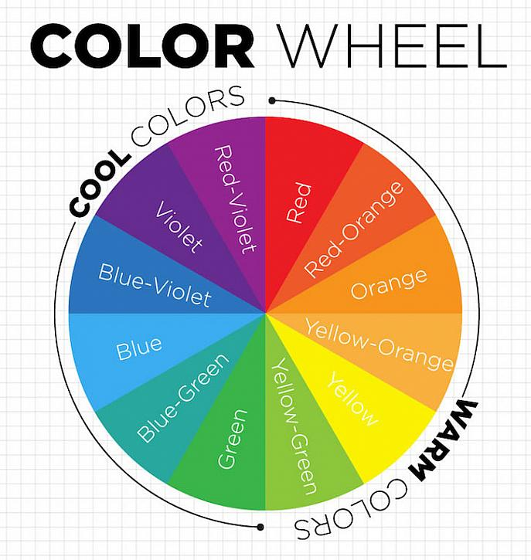
Find something...
…that is your favorite color
Notes:
As you work through the slides slow things down, be curious, ask open-ended questions and reflect, reflect, reflect! This is a simple way to practice being present and practicing what something as simple as favorite color means to the individual.

Slide 3
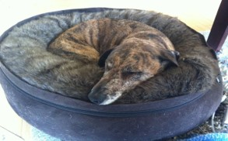
Find something...
…that brings you comfort
Notes:
How to use one Scavenger item as an Enactment:
Client searches for item and brings it back to the computer
Clinician: Reflect, affirm etc. Follow-up prompts/questions:
Are you able to get _____________ when you need it?
When do you need comfort?
Let’s practice that so you feel confident next time _________ happens.
Does _______ know that this helps you? Let practice telling ______ that you have an awesome idea on how to feel better when things get tough.
Practice with the child telling their caregiver about what gives her them comfort and why.
Work with the caregiver 1:1 to accept the message in a way to creates a corrective emotional experience.
Set up an enactment where the child talks to the caregiver about what makes him/her feel comfort.
Your focus here will be dependent on the AFF. For example, if the AFF is Affective Responsiveness focus on how warmth and support is expressed by the caregiver and received by the child.
Follow the enactment check off on how to process the enactment, work through the 3 commitments etc.

Slide 4
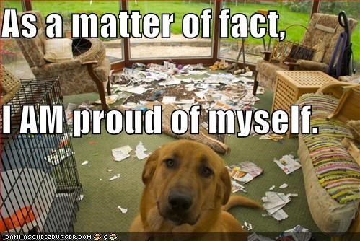
Find something...
…that you are proud of.
Notes:
Another opportunity to teach caregivers how to “catch the good.”
Put the caregiver in the driver’s seat. The more that the excitement, affirmations, exploration and attention is coming from the caregivers the more we are helping the family practice, create corrective emotional experiences and internalize the change.
Remember, the caregiver may not know how to show pride, approval or encouragement. Or, there may be an emotional block that needs to be worked through.
Schedule a session with the caregivers and coach them on how to receive this kind of message. Practice the words to use and find the words that make sense to the family. Then practice, practice, practice.
Bring the child and caregiver(s) together and let then go for it! Remember to stay directive as needed but never central.
Don’t forget to debrief how this was for the family. How was it different? Did you like it? Why or why not? Slow down here; it may be hard for the family to articulate.
Normalize that this can be hard (even if you think it shouldn’t be.) Massive joining opportunity when we can understand how something that seems easy to us is very hard for someone else.
Follow the enactment check off on how to process the enactment, work through the 3 commitments etc.

Slide 5
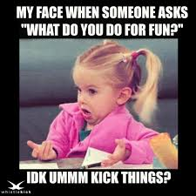
Find something...
…you like to do for fun.
Notes:
Lighten things up periodically to keep the momentum going. It is ok to goof off a little bit.

Slide 6
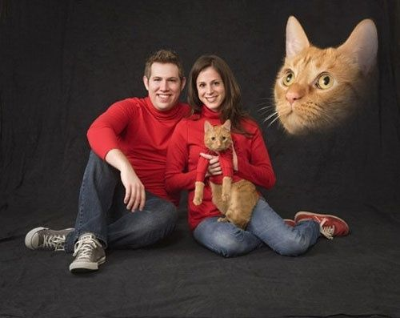
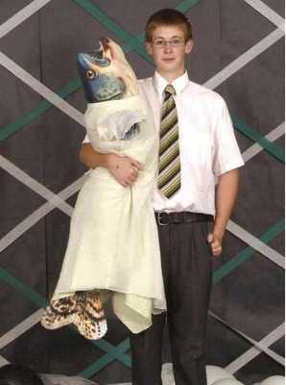
Find something...
…a favorite photo or
picture
This Photo by Unknown Author is licensed under CC BY-SA-NC
Notes:
Be prepared to unpack a lot from this one.
Prompt the caregiver to lead the family in making photo albums. This may be especially relevant given that pictures are now often stored digitally. You can make a digital photo album also.
Depending on the age, prompt the caregiver to go through old photos, share family stories, talk about photos taken the day the child was born. This may be particularly relevant to families struggling with Affective Involvement. Going back to a time when bonds where stronger can bring up visceral feelings between family members.

Slide 7
Find...
…a book that you love
Notes:
Ask, or better yet, practice and prompt the caregiver to ask…
What is it about this story that you like?
Can you relate to the characters? How?
Caregivers showing interest is a way to show attention. Showing attention, even to a book a kid likes can be framed as showing love. Please watch the movie Lady Bird for outstanding exploration of attention and love. It is basically a two hour reframe.

Slide 8
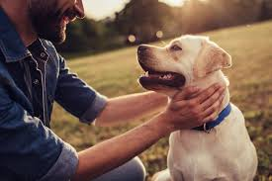
Find something...
…that helps you feel calm
Notes:
Here are getting into some practical skills and solutions.
This may also dovetail into reviewing Solution Cards.
Find ways to involve interaction, both within the family (being held) and maintaining social connections outside of the family via Zoom etc.
Remember, the best way to utilize this tool is that you run through it with the caregiver(s), define roles, practice with them and cue it up during a session with the kids.
Or, you can run through with the kids to get their output and then circle back with the parents so they can fulfill their role.

Slide 9
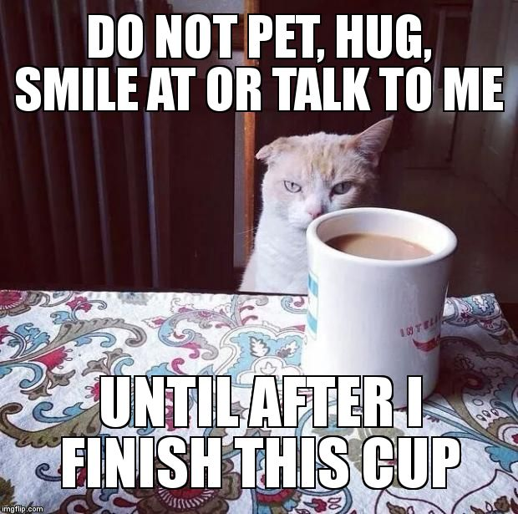
Find something...
…that you use every morning.
Notes:
Again, weaving in lighter hunts

Slide 10
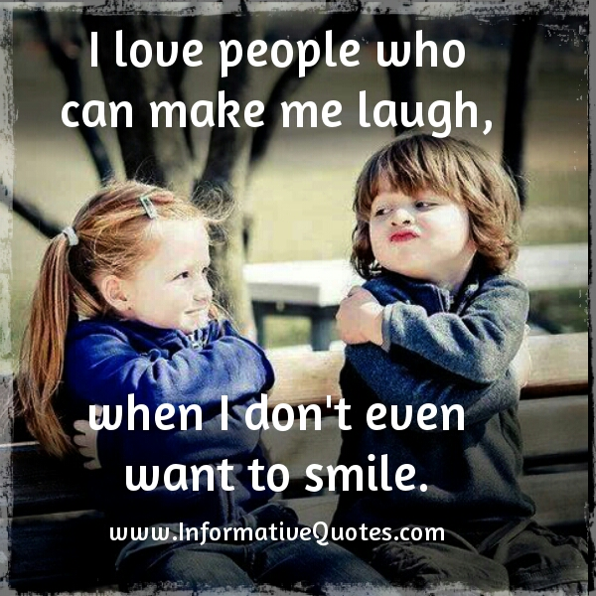
Find something...
…that makes you laugh.
Notes:
Get ready to goof off here and blow off some steam.
Come prepared with something to share that makes you laugh.

Slide 11
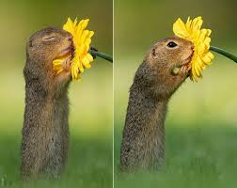
Find something...
…that smells good to you.
Notes:
There is a very strong neurological connection between smell and memory.
Ask them to share what memories they associate with that smell.

Slide 12
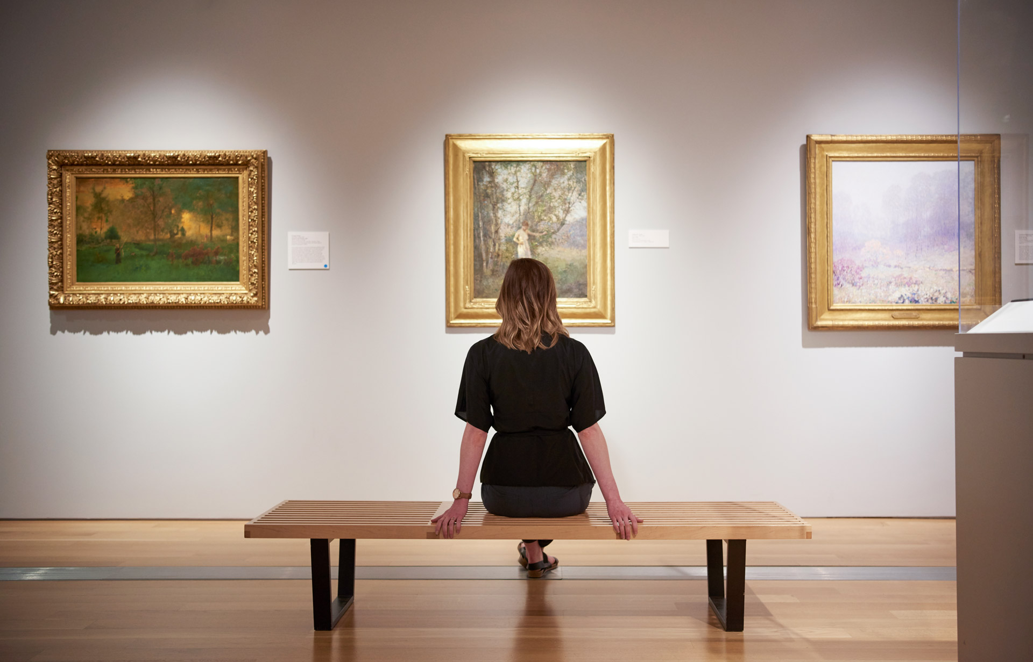
Find something...
…that you enjoy looking at.
Notes:
Another fun one woven in to keep the momentum

Slide 13
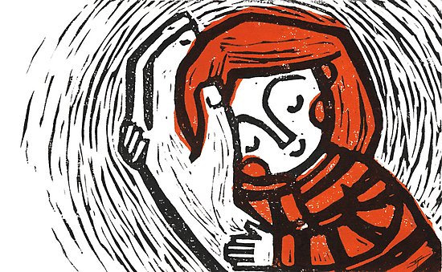
Find something...
…that makes you feel safe.
Notes:
What is not said may be as important as what is said.
Is the safe thing a person? Is that person in the home? Do they have access to this thing or person?
Questions to explore:
What does it mean to feel safe?
When do you feel safe?
When do you not feel safe?
How does _________ make you feel safer?
Is there anything anyone can do in your family to make you feel safer?
Can create an enactment based on the format offered above based on the answer here.
Practice communicating this need, then invite the person identified in the session.
Focus on the child reaching out and the caregiver taking hold of them
Make the experience safe!

Slide 14
Find something...
…that you made!
Notes:
Another opportunity to share interest, affirmations, reward hard work etc.
In what other ways does hard work show up in your family?
What are some things that you need to work a little harder at?
Can you commit to that right now? Ask your mom to join us so you can tell her.

Slide 15
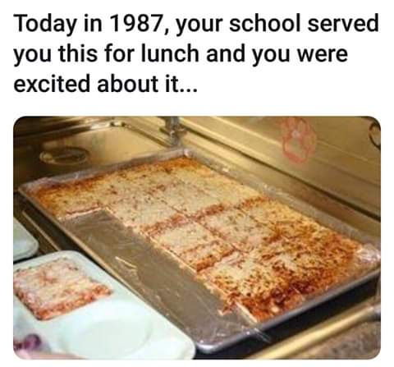
Find something...
…that reminds you of school.
Notes:
Have you told your mom/dad that they are doing a good job taking over as your teacher?

Slide 16
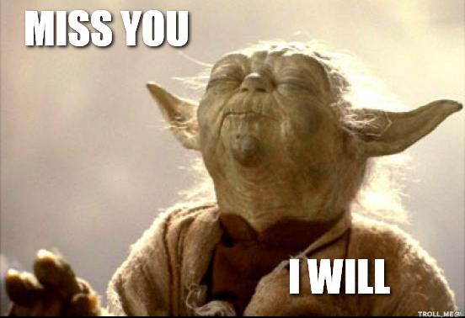
Find something...
…that reminds you of someone you miss.
Notes:
Another place to slow down.
Prompt them to write the person a letter or email.
Who do you think misses you? Why? What are all the reasons someone might miss you?
Again, if you can coach the caregiver to use these words or similar words that make sense to them you are doing enactments and family is experiencing corrective emotional experiences.

Slide 17
Find something...
…that reminds you of someone you love.
Notes:
Very similar to the previous. Slow down and find opportunities for enactments in the moment.

Slide 18
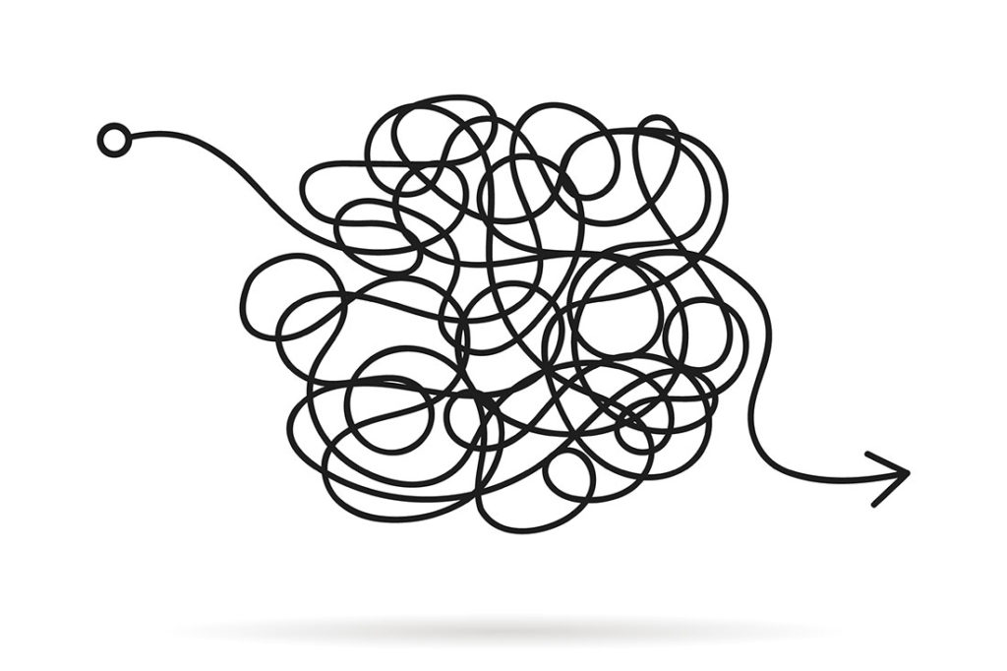
Find something...
…that represents a problem that you are having right now.
Notes:
After using empathic reflections to demonstrate encourage the person to take responsibility for their role in the problem.
Use Reversals, Reframe, and creating ownership to remove the problem from an individual and make it an interactional issue.

Slide 19
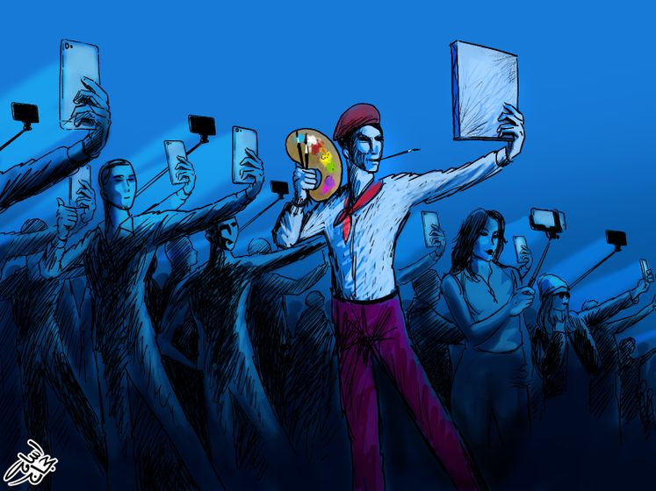
Find something...
…that says something unique about you.
Notes:
Do you think that people understand your uniqueness?
If no, what do you want them to understand?
Why is important to be unique? Why is it important to go with the crowd?

Slide 20
Find something...
…that expresses your personality.
Notes:
Very similar to the previous.
Ask them to find things that reflect the personalities of all family members.
This can lead directly into the Family Sculpt. See the All Interventions document in the digital library for instructions on the Family Sculpt

Slide 21
Find something...
…that brings back a happy memory.
Notes:
Keeping it light to keep the momentum.

Slide 22
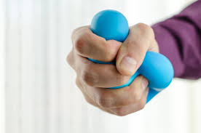
Find something...
…that you can use when you are stressed out.
Notes:
Stress balls can be made with common household ingredients. Create an enactment on making family stress balls
Make a plan
Get ingredients
Who will lead the activity
How do you introduce new ideas to the project?
How do you express disagreement in how you are doing the project?
How will you work together?

Slide 23
Find something...
…that represents a problem that your family is having right now.
Notes:
Does your family know that you think/feel that way?
Can you find the courage to tell them? I can help…we can practice until is sounds right.
Prep caregiver to hear and receive the message without getting angry or defensive.
Use the Alter Ego to slow down the interaction and get to the underlying issue.

Slide 24
Find something...
…of your choice.

